Slide 1
Longest Common Subsequence (LCS)
Problem: Given sequences x[1..m] and y[1..n], find a longest common subsequence of both.
Example: x=ABCBDAB and y=BDCABA,
  BCA is a common subsequence and
  BCBA and BDAB are two LCSs

Slide 2
LCS
Brute force solution
Writing a recurrence equation
The dynamic programming solution

Slide 3
Brute force solution
Solution: For every subsequence of x, check if it is a subsequence of y.
Analysis :
  There are 2^{m} subsequences of x.
  Each check takes Ο(n) time, since we scan y for first element, and then scan for second element, etc.
  The worst case running time is Ο(n2^{m}).

Slide 4
Writing the recurrence equation
Let X_{i} denote the ith prefix x[1..i] of x[1..m], and
X₀ denotes an empty prefix
We will first compute the length of an LCS of X_{m} and Y_{n}, LenLCS(m, n), and then use information saved during the computation for finding the actual subsequence
We need a recursive formula for computing LenLCS(i, j).

Slide 5
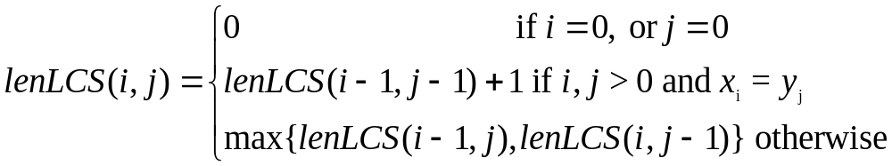
The recurrence equation

Slide 6
The dynamic programming solution
Initialize the first row and the first column of the matrix LenLCS to 0
Calculate LenLCS (1, j) for j = 1,…, n
Then the LenLCS (2, j) for j = 1,…, n, etc.
Store also in a table an arrow pointing to the array element that was used in the computation.
It is easy to see that the computation is O(mn)

Slide 7
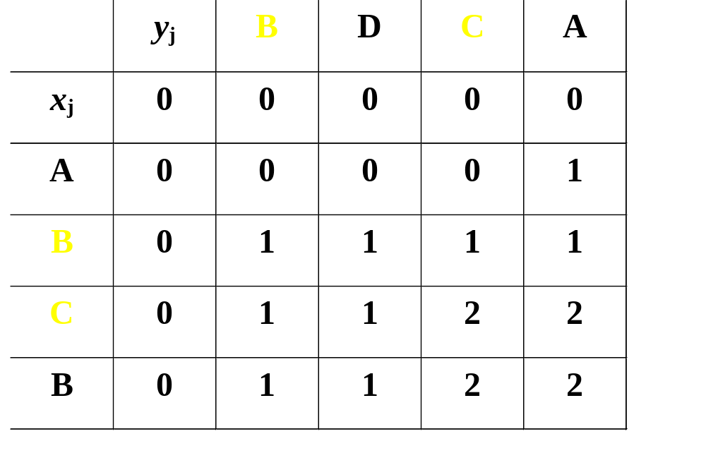
Example
To find an LCS follow the arrows, for each
diagonal arrow there is a member of the LCS

Slide 8
LCS-Length(X, Y)
m ← length[X}
n ← length[Y]
for i ← 1 to m do
c[i, 0] ← 0
for j ← 1 to n do
c[0, j] ← 0

Slide 9
LCS-Length(X, Y) cont.
for i ← 1 to m do
for j ← 1 to n do
if x_{i} = y_{j}
c[i, j] ← c[i-1, j-1]+1
b[i, j] ← “D”
else
if c[i-1, j] ≥ c[i, j-1]
c[i, j] ← c[i-1, j]
b[i, j] ← “U”
else
c[i, j] ← c[i, j-1]
b[i, j] ← “L”
return c and b

Slide 10

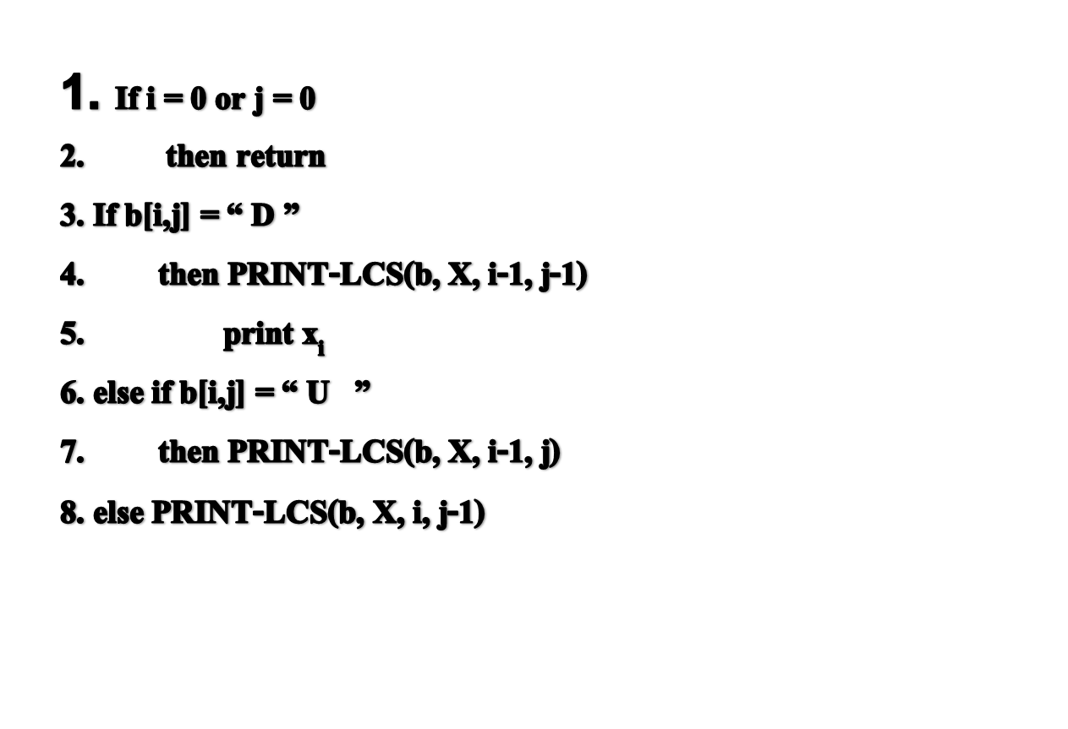

Slide 11
Questions
How do we find the LCS of the following two Strings?
A= “ATCGATTA”
B= “ CGGATAT”

